Slide 1
CGB1201 – JAVA PROGRAMMING
Department of Artificial Intelligence and Data Science
Academic Year: 2024 – 2025 (Odd Semester)
Register Number : 2303811724322102
Name : Shamitha Sri R
Year : II
Semester : III
Section : B
Date : 3-12-2024

Slide 2
Title of the Project
MOBILE TRACKING SYSTEM
Design and develop a mobile tracking system that allows users to track the real-time location of mobile devices. The system should provide functionalities for locating lost or stolen devices, monitoring device movement, and securing sensitive data remotely. The goal is to enhance device security and provide peace of mind to users in case of loss or theft.

Slide 3
Problem Identification
1.Difficulty in locating lost or stolen mobile devices.
2. Lack of real-time tracking solutions for family members or employees.
3. Privacy concerns and unauthorized access to location data.
4. Inefficiency in tracking in low-signal areas.
5. High dependence on third-party apps for basic tracking functionality.

Slide 4
Objective
The objective of the Mobile Tracking System is to provide users with a reliable and secure solution to locate, monitor, and control their mobile devices in real-time. This system aims to enhance device security by enabling users to track the exact location of their devices, and safeguard sensitive data through remote functionalities such as locking or wiping.

Slide 5
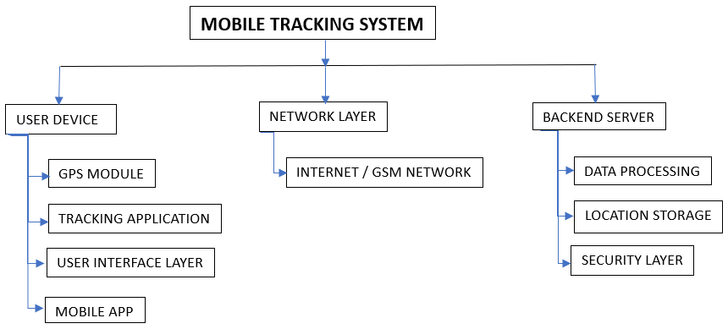
Proposed Architecture

Slide 6
Java Programming - Concepts Used
Object-Oriented Programming (OOP)
Classes and Objects
Multithreading

Slide 7
List of Modules
User Authentication Module
Real-Time Location Tracking Module
Security Management Module
Data Encryption and Privacy Protection Module
Backup and Recovery Module

Slide 8
Module Description
1. User Authentication Module
Purpose:
It handles user registration, login, session management, and secure authentication mechanisms.
2. Real-Time Location Tracking Module
Purpose:
The Real-Time Location Tracking Module enables the tracking of mobile devices by providing live location updates to users.

Slide 9
Module Description (Cont..)
3. Security Management Module
Purpose:
It offers actions like locking the device, erasing data, and activating an alarm.
4. Data Encryption Module
Purpose:
It is securely encrypted to protect user privacy and safeguard against unauthorized access.

Slide 10
Module Description (Cont..)
5. Backup and Recovery Module
Purpose:
The Backup and Recovery Module ensures that important device and user data, such as location history, device status, and user preferences.

Slide 11
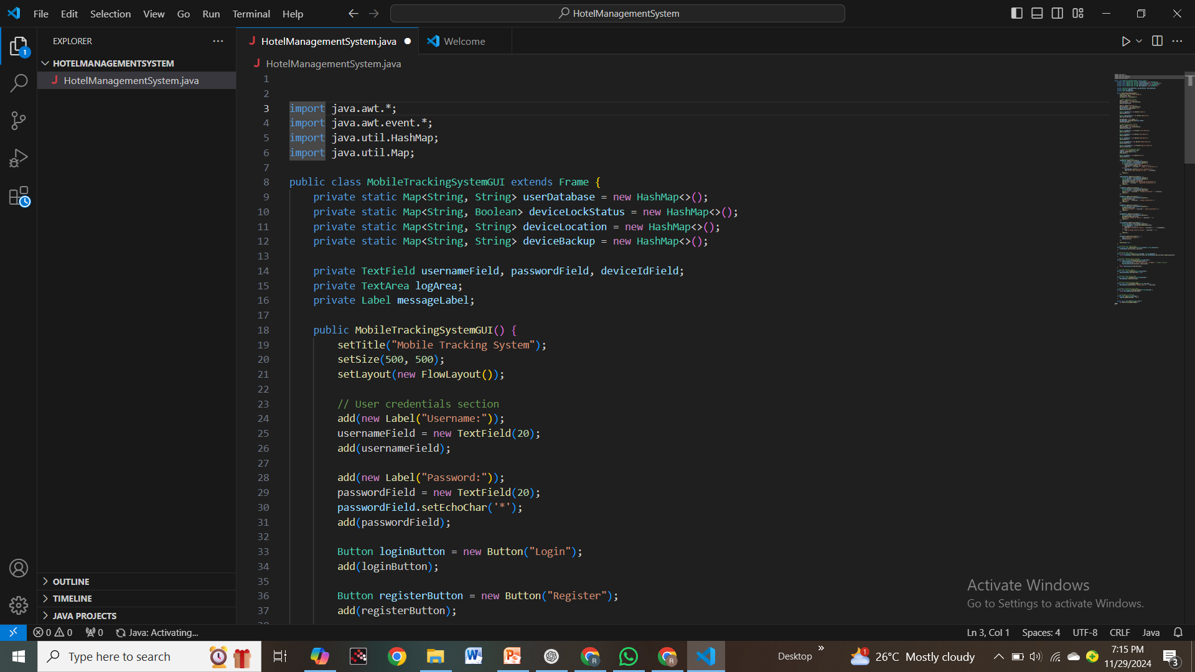
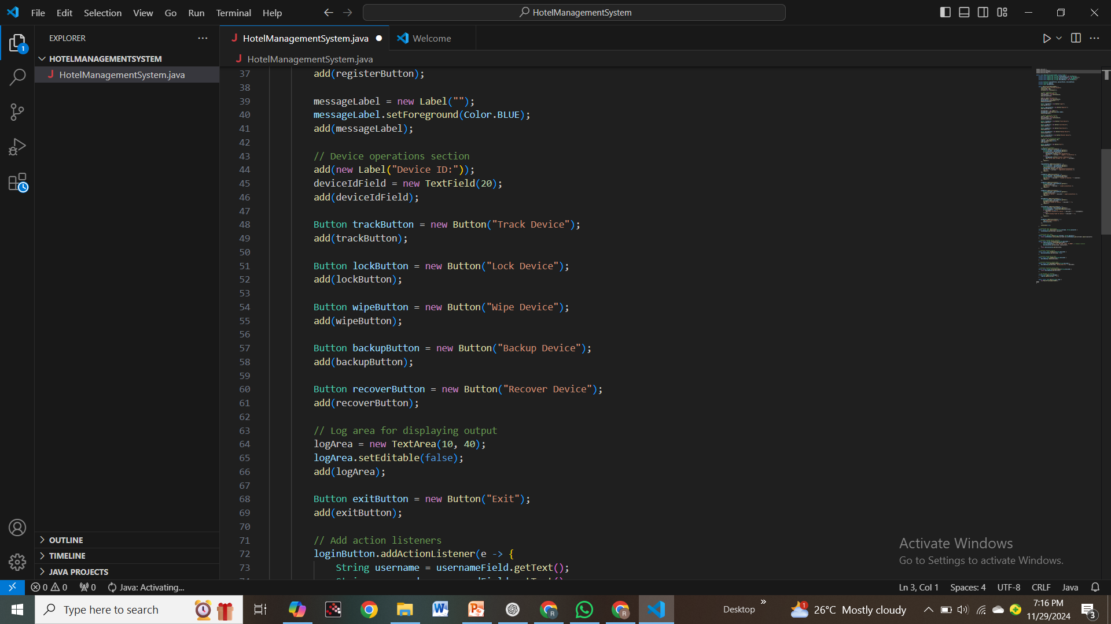
Source Code

Slide 12
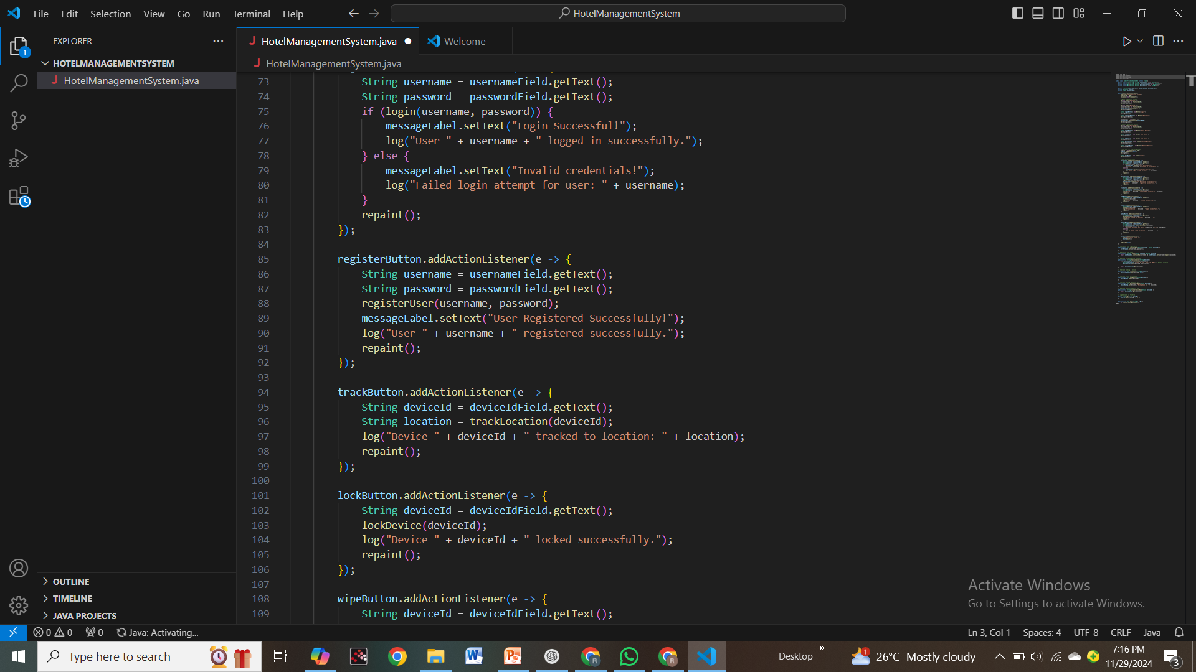
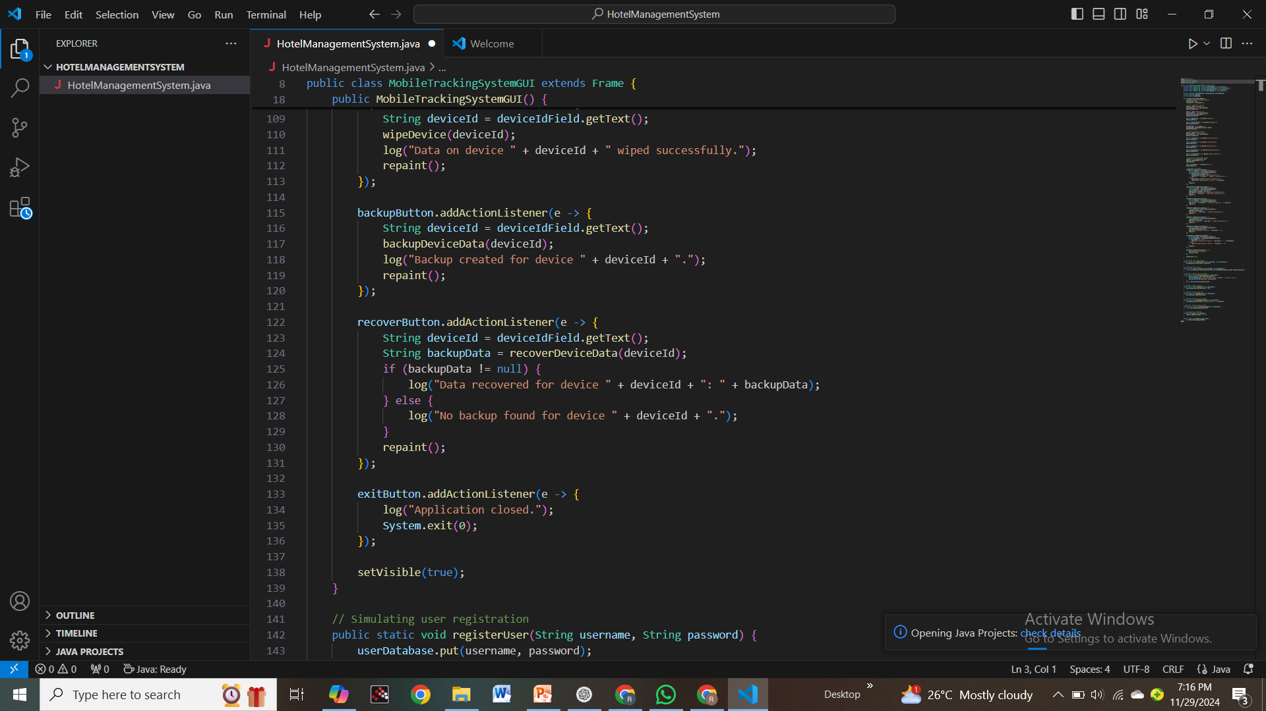
Source Code

Slide 13
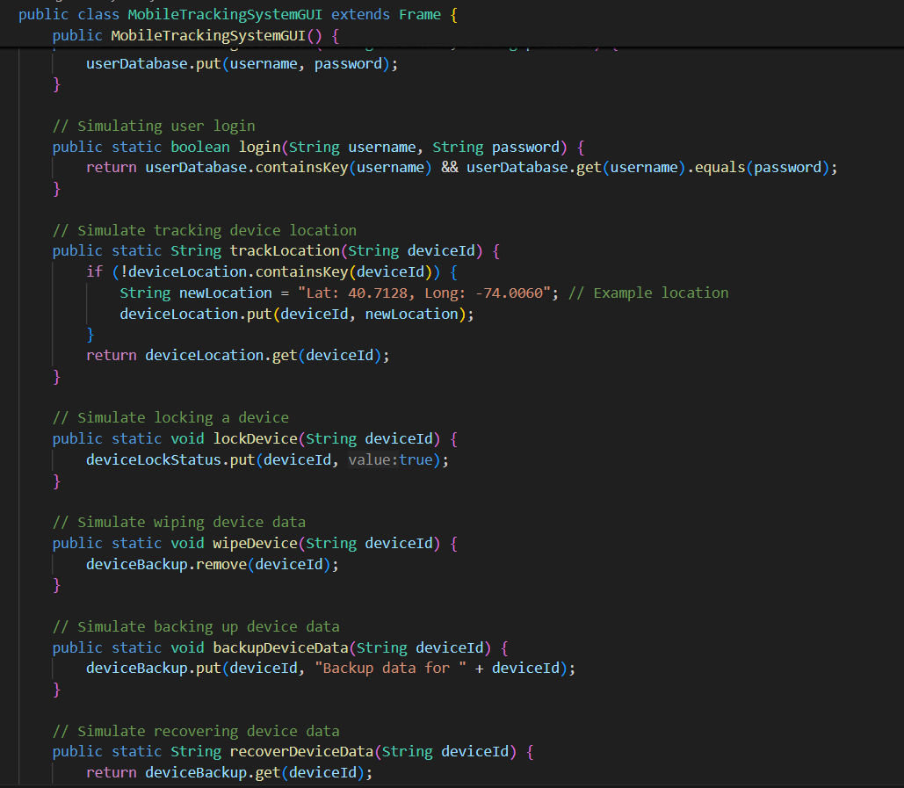
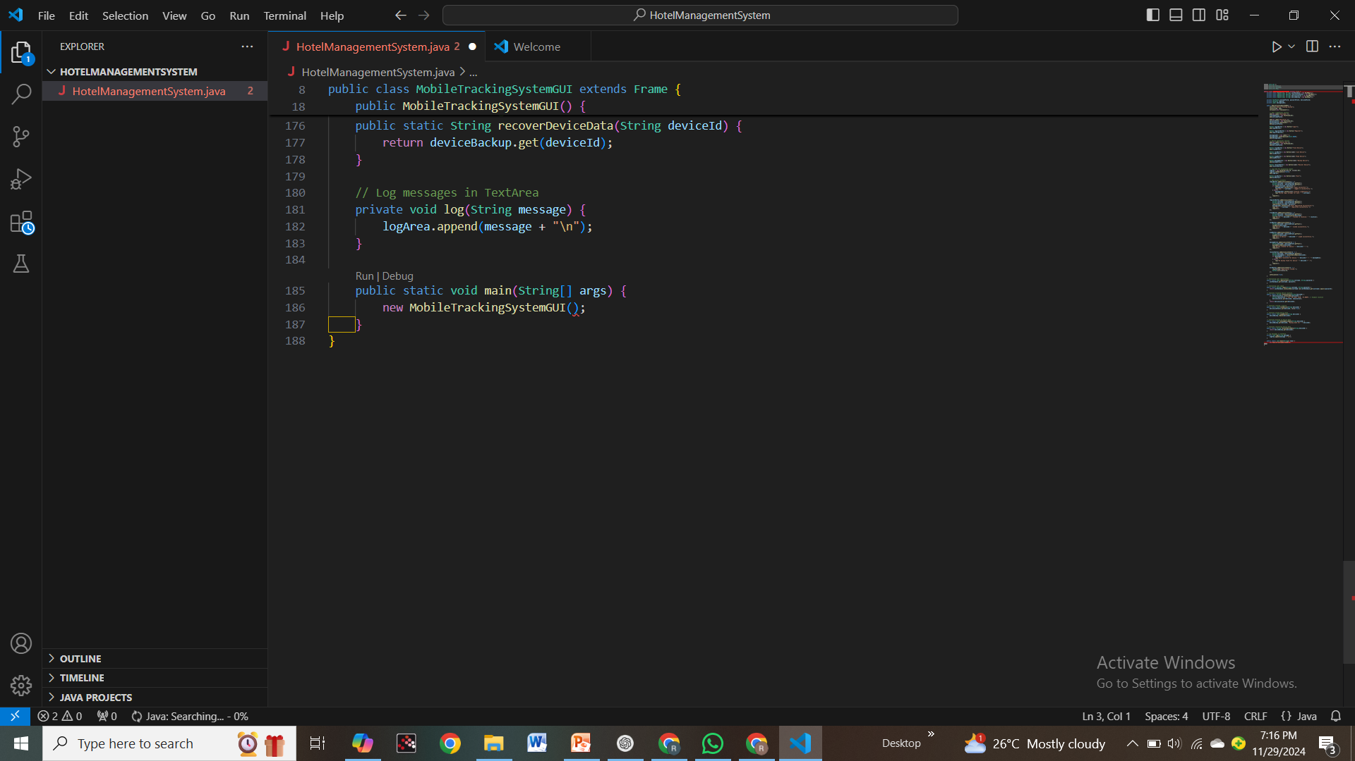
Source Code

Slide 14
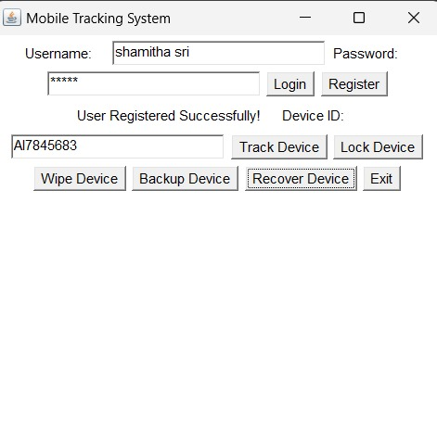
Results

Slide 15
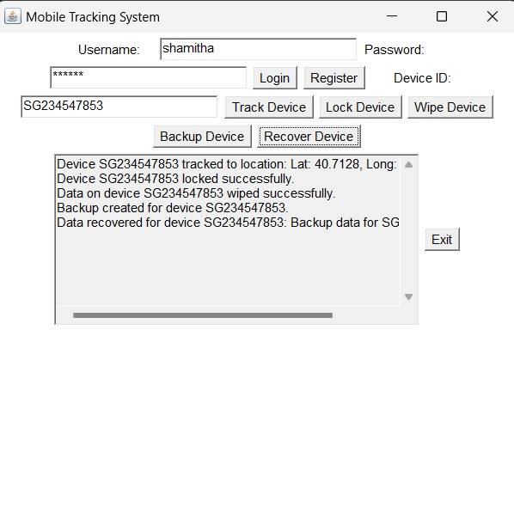
Results

Slide 16
Conclusion
The Mobile Tracking System project incorporates a wide range of features that enhance the security, monitoring, and management of mobile devices. By implementing core functionalities such as real-time location tracking, geofencing , device security management, and data encryption.

Slide 17
Thank You!

